Slide 1
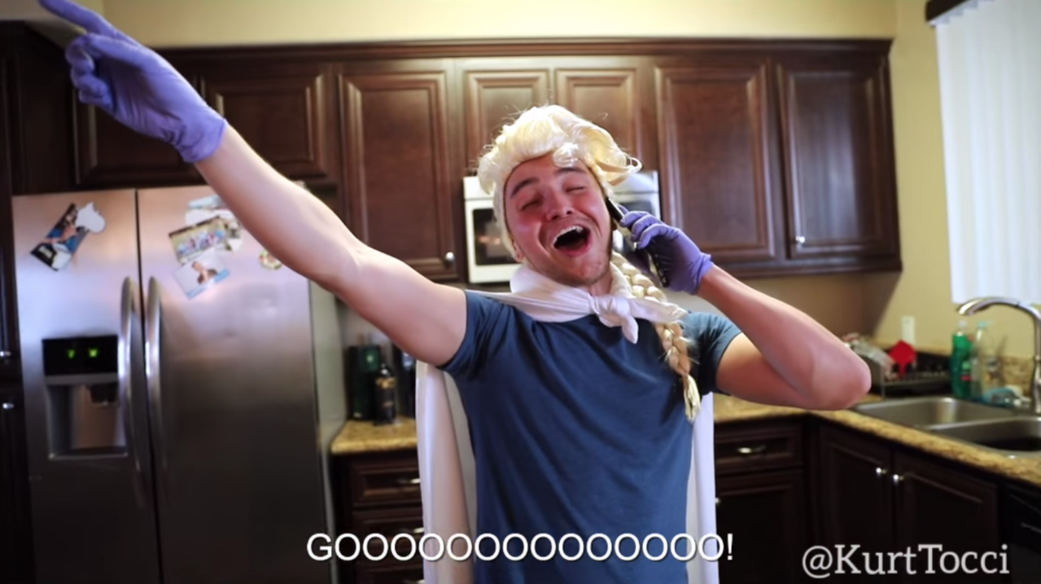
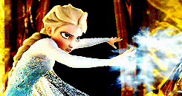
Yes! Yes!
Of course!
Please don’t copy me again!
Did you finish your homework?

Slide 2
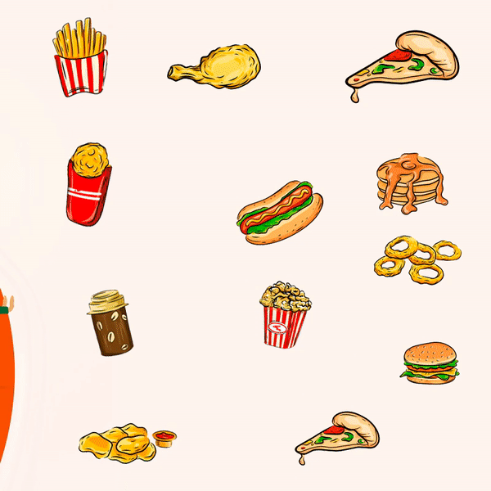
Unit 4:
What do you want?

Slide 3
fly
a hot dog

Slide 4
jump
an egg

Slide 5
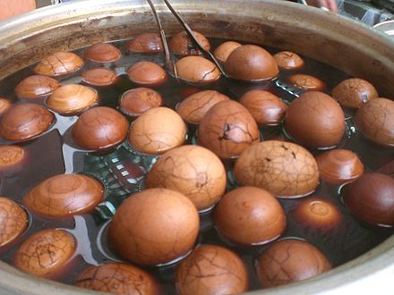
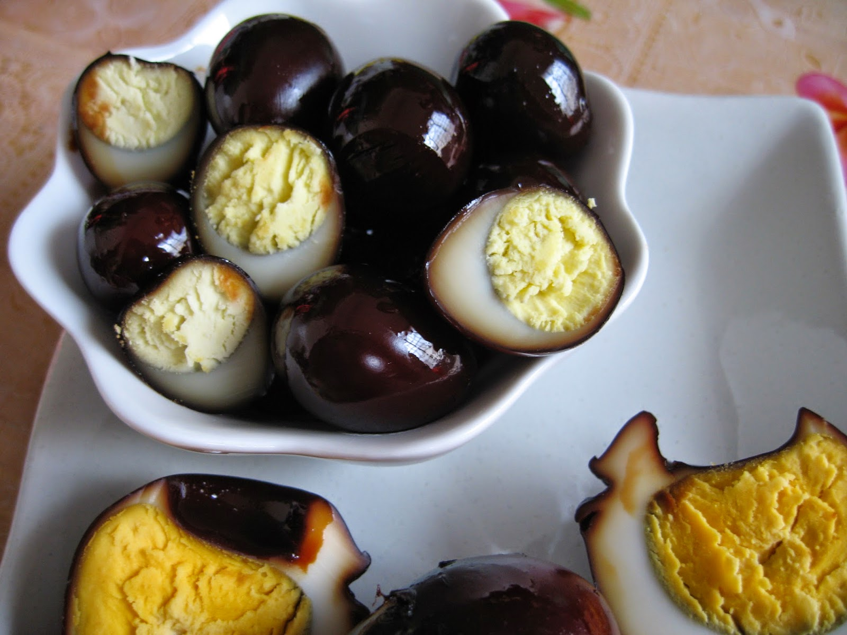
tea egg
iron egg

Slide 6
swim
a cupcake

Slide 7
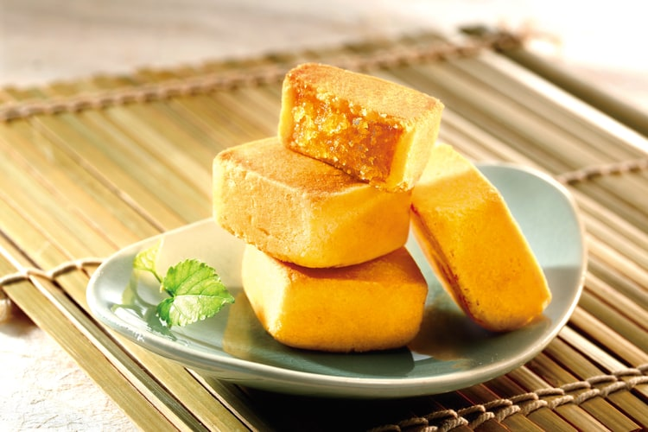
pineapple cake

Slide 8
sing
bread

Slide 9
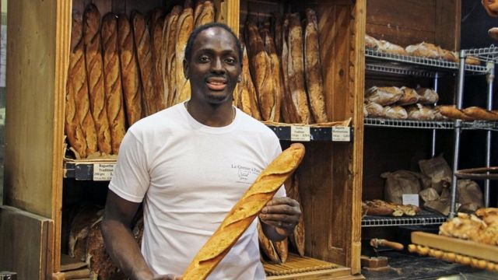
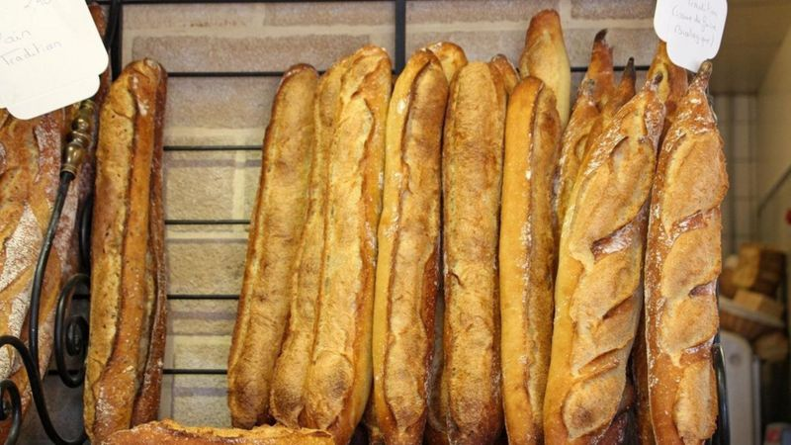
baguette

Slide 10
sing
juice

Slide 11
swim
milk

Slide 12
swim
tea

Slide 13
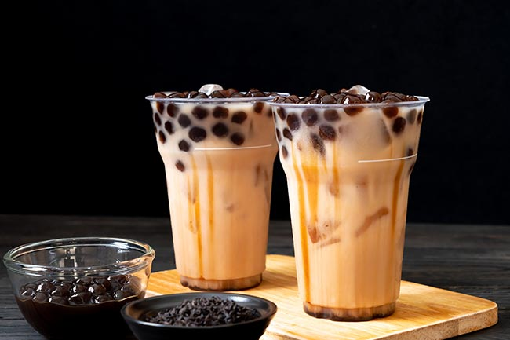
bubble milk tea

Slide 14
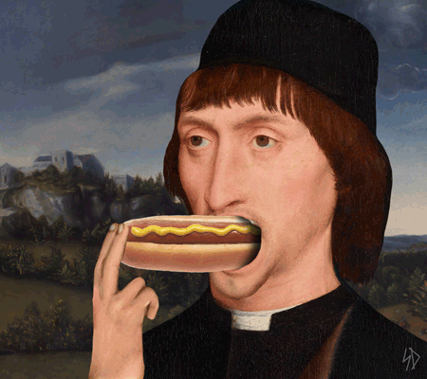
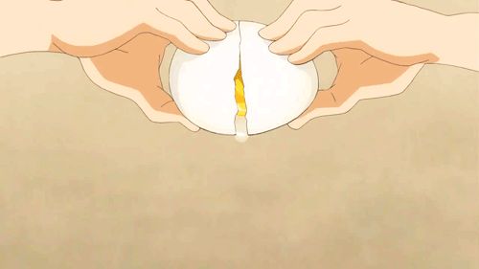
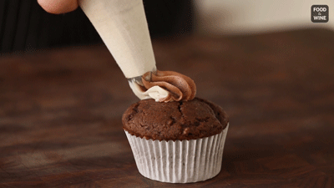
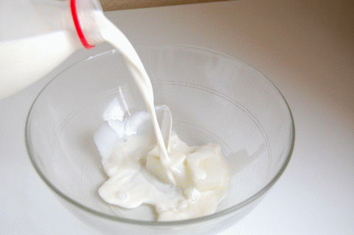
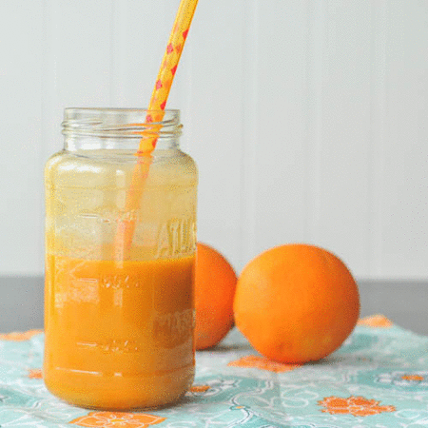
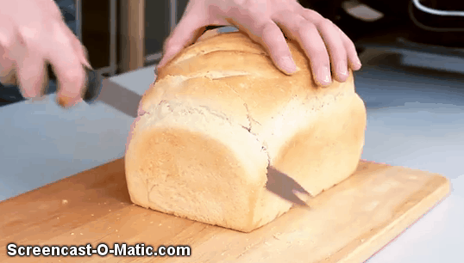
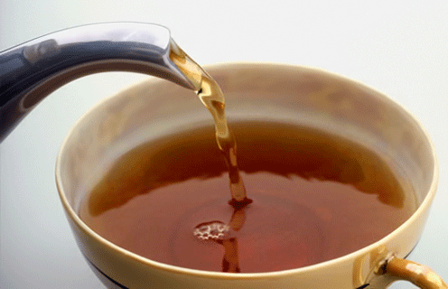
2
a cupcake
1
3
an egg
a hot dog
milk
6
5
7
4
bread
juice
tea

Slide 15
fly
I want a hot dog.

Slide 16
jump
I want an egg.

Slide 17
swim
I want a cupcake.

Slide 18
sing
I want some bread.

Slide 19
sing
I want some juice.

Slide 20
swim
I want some milk.

Slide 21
swim
I want some tea.

Slide 27
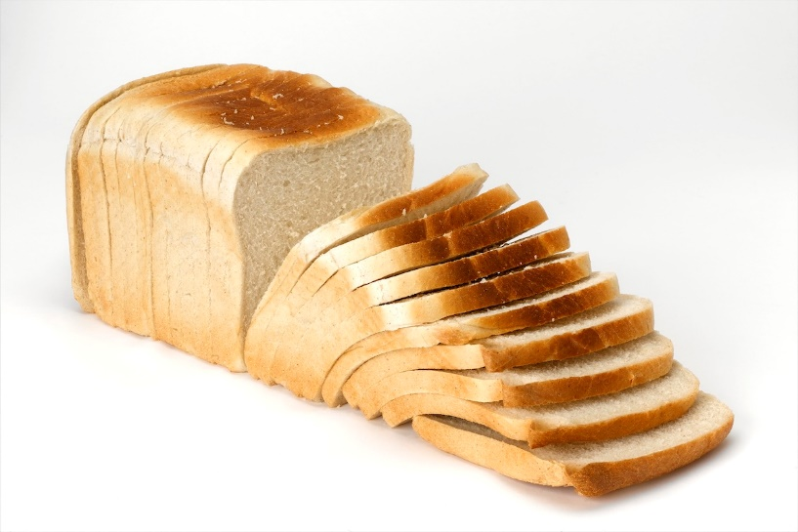
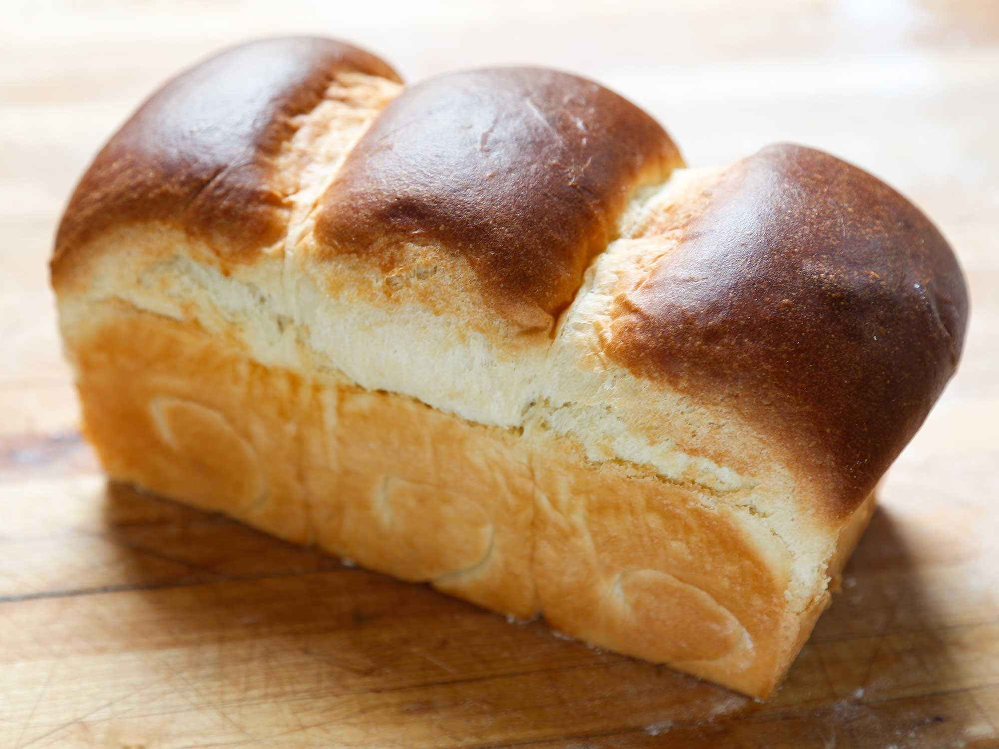
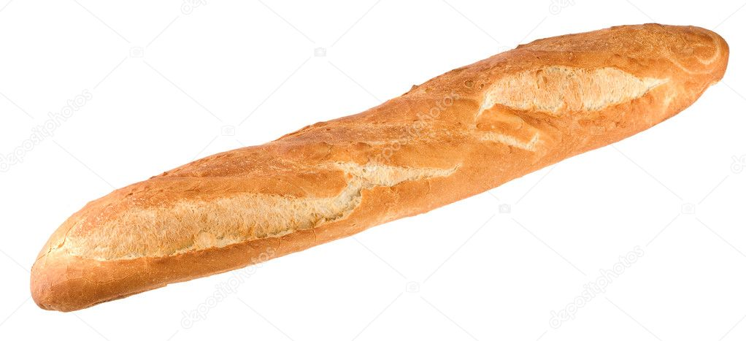
bread在英文裡為什麼是不可數的?
麵包有許多的種類，切片麵包中的一片要說（a slice of bread), 法棍這樣的一條要說
（a loaf of bread)。
所以bread在英語中是不可數名詞。

Slide 28
a
some
an
方便好用!!
用在可數複數名詞或不可數名詞都可以!!!

Slide 29
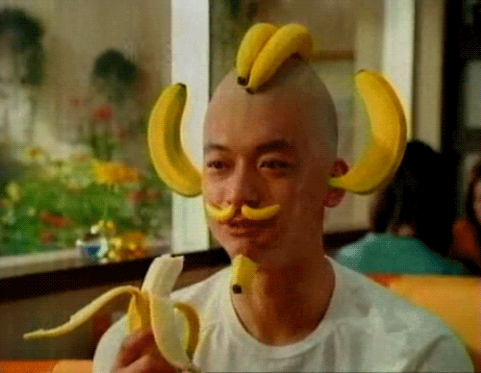
___ bananas
some

Slide 30
____ apple
an

Slide 31
___ watermelon
a

Slide 32
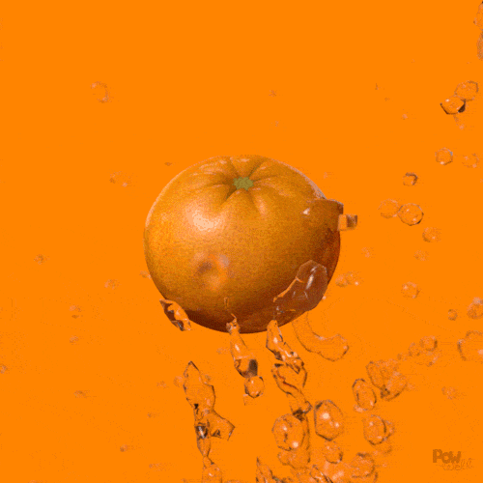
___ orange
an

Slide 33
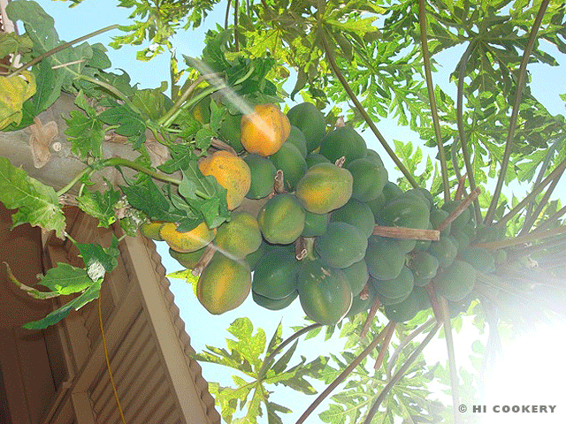
____ papayas
some

Slide 34
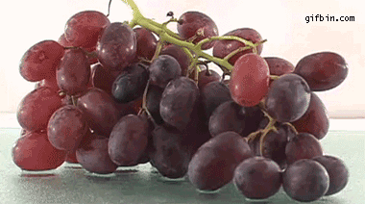
____ grapes
some

Slide 35
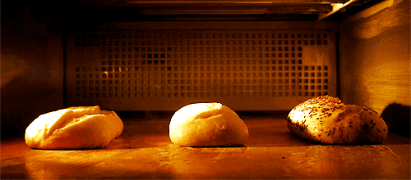
____ bread
some

Slide 36
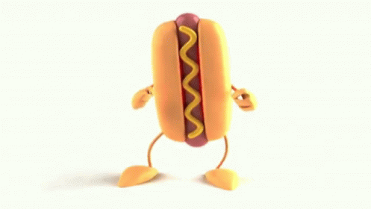
_____ hot dog
a

Slide 37
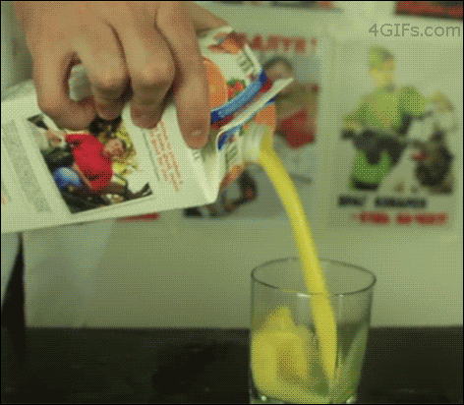
____ juice
some

Slide 38
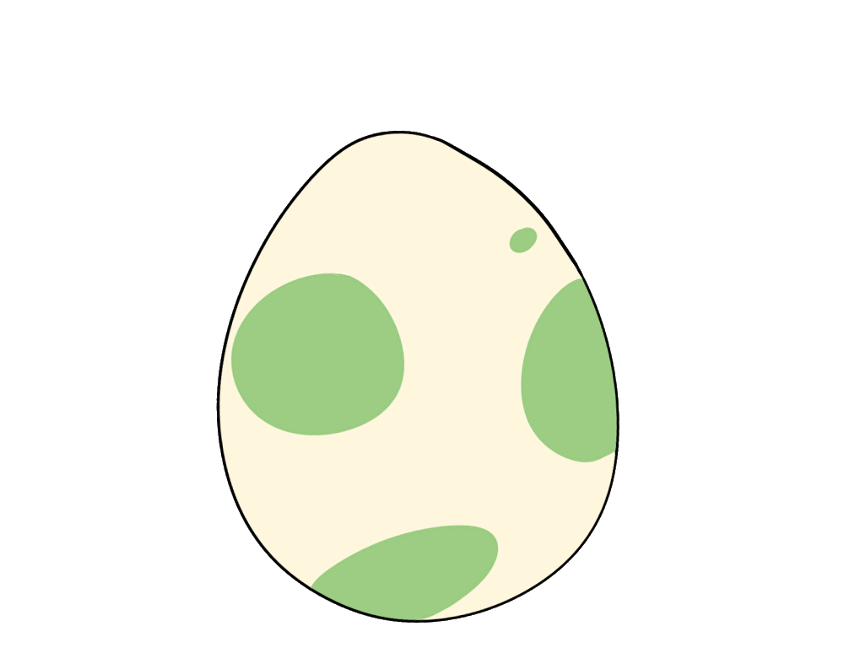
_____ egg
an

Slide 39
____ tea
some

Slide 40
_____ cupcakes
some

Slide 41
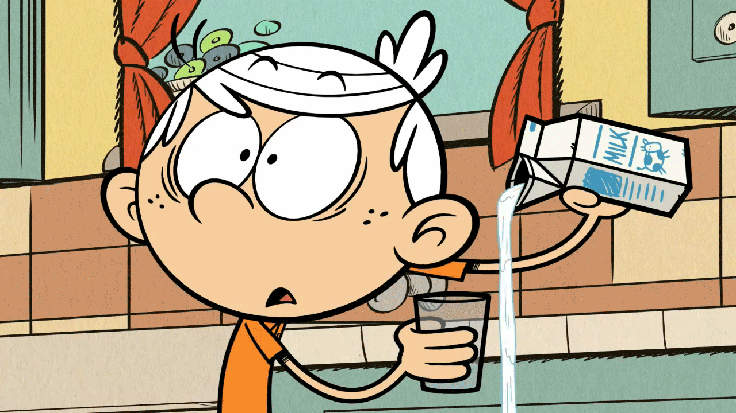
____ milk
some

Slide 42
Homework this week
聽: CD2第29-33首。
說&讀:聽CD時跟著大聲唸。完成3遍
請家長在課本P62簽名可換印章。
寫: 英語習作P52~55，下週一交。

